Slide 1
DEMO II
ZOLTÁN NÉMETH

Slide 2
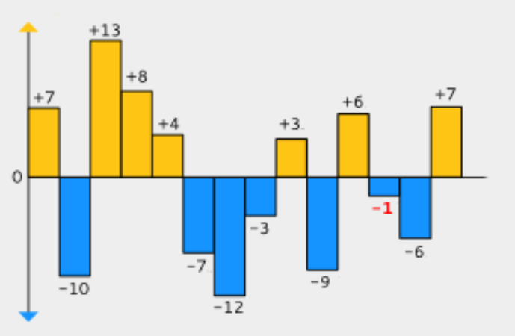
DOJO: TEMPERATURES

Slide 3
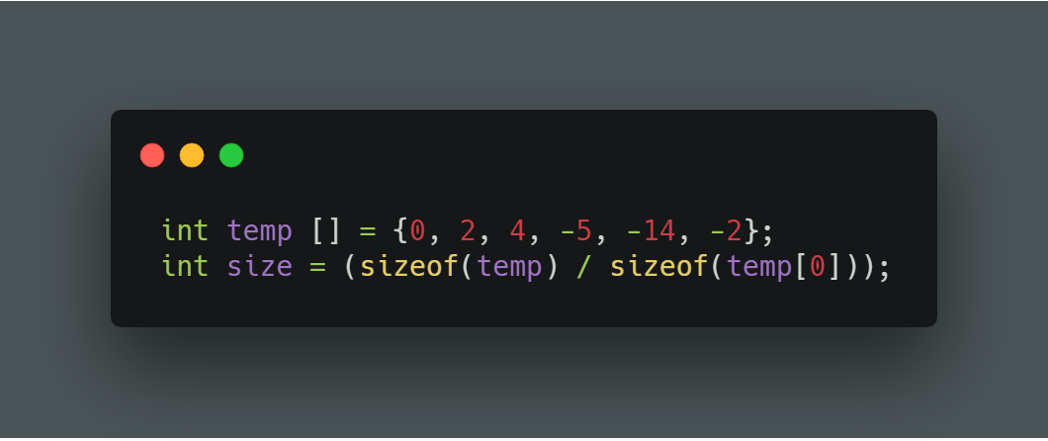
TEMPERATURES
Code should be written in int(main)

Slide 4
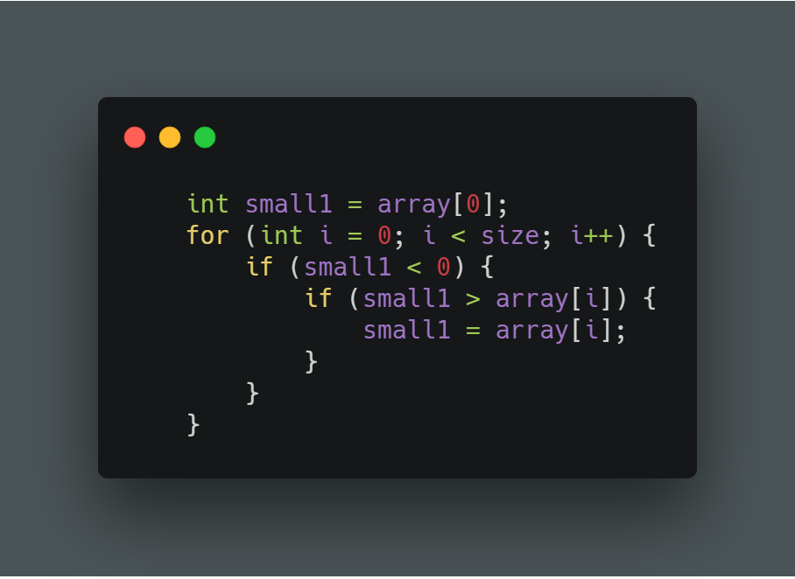
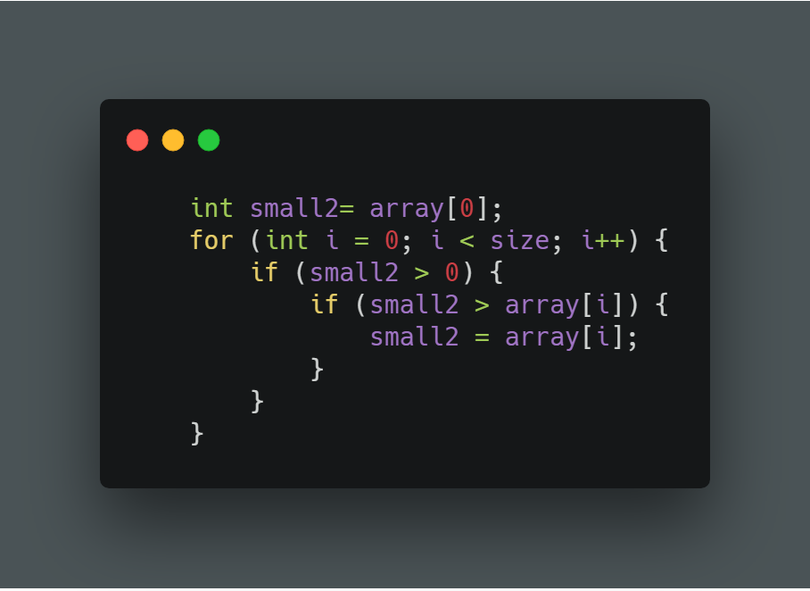
TEMPERATURES
Check positive and negative numbers!

Slide 5
